Slide 1
Have a seat.
Have a say.

Slide 2
Headline
Presenters:
Date:

Slide 3
AGPT Workforce Planning and Prioritisation Program (WPP)
Evidence-based reports to the Commonwealth Department of Health and Aged Care (DOHAC) to inform and support the RACGP and ACCRM with the placement of AGPT registrars, based on need and capacity
Robust quantitative analysis (using the C/w’s Health Demand and Supply Utilisation Patterns Planning tool (HeaDS UPP) and local place based qualitative information to provide a comparative analysis of GP catchments across Victoria
Validation of the analysis through consultation with local and key stakeholders

Slide 4
For 2025, all the States and Territories WPP organisations, will use the new
General Practitioner National Assessment Tool (GP NAT)
Co-developed by DOHAC and the WPPOs
National consistent approach
Baseline data converted into a series of weighted indicators to measure relative workforce need and training capacity
Rankings and groupings to prioritise GP catchments by each PHN catchment

Slide 5
Murray PHN catchment
Donec sem ex, mattis vel fringilla bibendum, gravida id neque.
Nac scelerisque gravida, lacus urna.
Libero augue in libero.
Ante non massa volutpat rhoncus eu sed.
Praesent nibh libero, pulvinar eu est eu.

Slide 6
National Medical Workforce Strategy 2021 – 2031 Investing in our medical workforce to meet Australia’s health needs
NAT
DPA
Implementing
Responding to
Continuing to investigate
Australian General Practice Training
(AGPT) program
Review of General Practice Incentives
Delivered September 2024
Complexity review
Currently underway
Workforce Planning & Prioritisation (WPP) program
A Better after-hours system – 2023/2024 Review of After-Hours Primary Care
Delivered August 2024.
Primary Health Network Review
Currently underway
Nationally consistent payments
19AB
GP Catchment
Single Employer Model
Working Better for Medicare Review
Delivered October 2024
Regional Generalist Training Scheme (RGTS)
Independent Review of health practitioner regulatory settings (KRUK Review)
Delivered December 2023.
DWS
Remote Vocational Training Scheme (RVTS)
19AA
MMM
Scope of Practice Review
Delivered October 2024

Slide 7
GP Workforce Planning and Prioritisation Organisations are responsible for developing annual Workforce Needs and Training Capacity Reports for the AGPT.
Looking ahead…
Objective 1 Deliver robust, independent, evidence based recommendations to the department on AGPT training placement priorities at GP catchment level
2025 focus
Outcome 1 Greater visibility of GP training opportunities to support GP registrars to complete their training in a single region as they progress through the medical pathway
Purpose
Support the transition to College-led GP training
Nationally consistent approach to inform a data driven KPI for AGPT program
Objective 2 Foster collaboration with relevant stakeholders in the PHN region to integrate their data, insights and expertise into the formulation of advice
Outcome 2 A well distributed workforce to service all Australian communities

Slide 8
Key facts: Victoria AGPT
 | 2025 (estimated) | 2024 | 2023 | 2022
Intake | 398 | 323 | 254 | 293
% of places filled | 133% | 111% | 88% | 92%

Slide 9
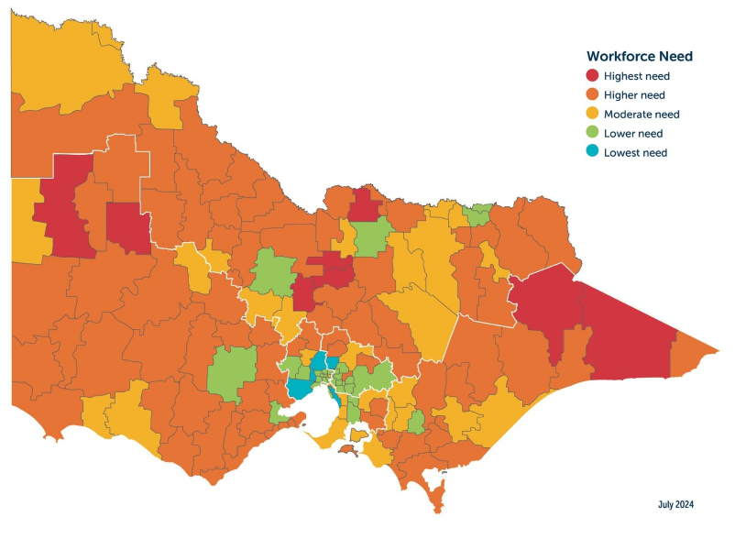
Victoria priority map - placeholder

Slide 10
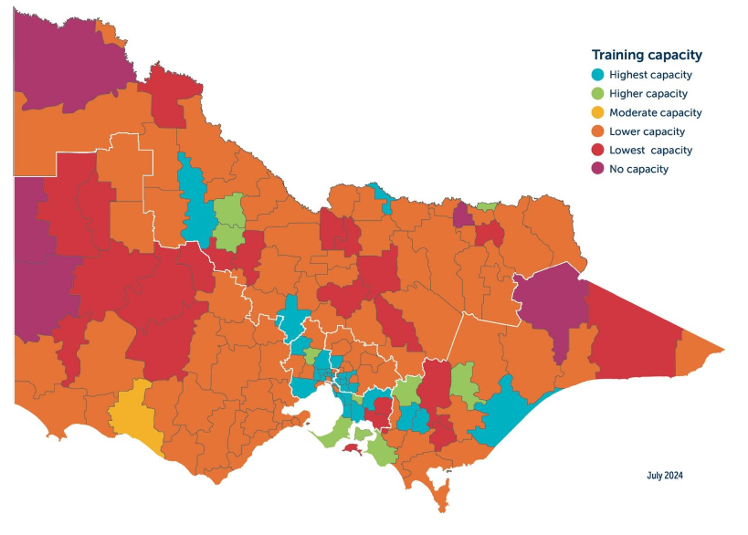
Victoria training capacity map OR your PHN placeholder

Slide 11
Victoria workforce need placeholder or your PHN

Slide 12
GP Catchment Code | GP Catchment | Workforce Need | Training Capacity | Priority Level
GP2001 | Alexandra | Higher Need | Lowest Capacity | Supervision support (P1)
GP2012 | Beechworth | Higher Need | Lower Capacity | Supervision support (P1)
GP2014 | Benalla | Moderate Need | Lower Capacity | Supervision support (P2)
GP2019 | Bright | Higher Need | Lower Capacity | Supervision support (P1)
GP2030 | Chiltern - Indigo Valley | Moderate Need | No Capacity | Broader workforce strategies (P2)
GP2036 | Corryong | Higher Need | Lower Capacity | Supervision support (P1)
GP2050 | Euroa | Higher Need | Lowest Capacity | Supervision support (P1)
GP2058 | Heathcote | Highest Need | Lower Capacity | Supervision support (P1)
GP2067 | Kilmore - Broadford | Higher Need | Lower Capacity | Supervision support (P1)
GP2082 | Mansfield | Moderate Need | Lower Capacity | Supervision support (P2)
GP2086 | Marysville | Higher Need | Lower Capacity | Supervision support (P1)
GP2096 | Mount Beauty | Moderate Need | Lower Capacity | Supervision support (P2)
GP2097 | Myrtleford | Higher Need | Lower Capacity | Supervision support (P1)
GP2098 | Nagambie | Highest Need | Lower Capacity | Supervision support (P1)
GP2099 | Nathalia | Higher Need | Lower Capacity | Supervision support (P1)
GP2102 | Numurkah | Highest Need | Lower Capacity | Supervision support (P1)
GP2115 | Rutherglen | Moderate Need | Lowest Capacity | Supervision support (P2)
GP2118 | Seymour | Higher Need | Lowest Capacity | Supervision support (P1)
GP2119 | Shepparton - Mooroopna | Lower Need | Lower Capacity | Supervision Support (P3)
GP2126 | Tallangatta | Higher Need | Lower Capacity | Supervision support (P1)
GP2127 | Tatura | Moderate Need | Lowest Capacity | Supervision support (P2)
GP2135 | Wangaratta | Moderate Need | Lower Capacity | Supervision support (P2)
GP2144 | Wodonga | Lower Need | Lower Capacity | Supervision Support (P3)
GP2148 | Yackandanda | Higher Need | Lowest Capacity | Supervision support (P1)
GP2151 | Yarrawonga | Higher Need | Lower Capacity | Supervision support (P1)
GP2152 | Yea | Higher Need | Lower Capacity | Supervision support (P1)
Regional priorities – your PHN placeholder

Slide 13
questions
Donec sem ex, mattis vel fringilla bibendum, gravida id neque.
Nac scelerisque gravida, lacus urna.
Libero augue in libero.
Ante non massa volutpat rhoncus eu sed.
Praesent nibh libero, pulvinar eu est eu.

Slide 14
assumptions
Victoria (and Australia) has a primary care workforce shortage that is greatest in rural and remote communities
Training of AGPT registrars does not exists in a vacuum. There are other trainees in practices and being supported by supervisors

