Slide 1
Postvention Protocol
Workshop tool to develop a Postvention Protocol for [region]
Presenter name/s
Position title/s
Date

Slide 2
Acknowledgement of Country
[Organisation] acknowledges we are meeting on [Traditional owner/s] Country, the unceded lands of the [Traditional owner/s] Peoples.
We pay our respects and give thanks to the Ancestors, Elders and Young People
for their nurturing, protection and caregiving of these sacred lands and waterways,
acknowledging their continuing cultural, spiritual and educational practices.
We are grateful for the sharing of Country and the renewal that Country gives us.
We acknowledge and express our sorrow that this sharing has come at a personal,
spiritual and cultural cost to the wellbeing of First Nations Peoples.
We commit to addressing the injustices of colonisation across our catchment, and to listening
to the wisdom of First Nations communities who hold the knowledge to enable healing.
We extend that respect to all Aboriginal and Torres Strait Islander Peoples.

Slide 3
Acknowledging lived experience
We acknowledge and deeply respect those with a lived or living experience of suicide -
including people who have experienced suicidal thoughts or behaviours, survived a suicide
attempt, cared for someone through suicidal crisis, or been bereaved by suicide.
It is through listening to and acting on the voices of people with lived experience, those who
provide services, those who fund services, and most importantly, those who use services that we will find the expertise we need to move towards meaningful change.
We honour the courage, strength, and resilience it takes to share these experiences, and we
recognise the profound impact they have on individuals, families, friends, and communities.

Slide 4
Considerations
Your safety is important.
Take a break if you need.
Today we will be discussing suicide and the effects on the community of suicide bereavement. However, we should avoid oversharing information about real events.
In particular, as per the Mindframe guidelines, we should avoid comments regarding means, time and place.
Source: Mindframe - a national program supporting safe media reporting, portrayal and communication about suicide, mental health concerns and alcohol and other drugs. https://mindframe.org.au/guidelines#Our-words-matter

Slide 5
Available supports
Service | Contact details | Service provision
Lifeline | Call: 13 11 14 Text: 0477 13 11 14 Visit: lifeline.org.au | Free 24/7 crisis support
13YARN | Call: 13 92 76 Visit: 13yarn.org.au | Free 24/7 Aboriginal and Torres Strait Islander service
Kids Helpline | Call: 1800 55 1800 Visit: kidshelpline.com.au | Free 24/7 support for young people aged 5-25.
Qlife | Call: 1800 184 527 Visit: qlife.org.au | Free 3pm – midnight LGBTIQA+ service
Suicide Call Back Service | Call: 1300 659 467 Visit: suicidecallbackservice.org.au | Free 24/7 phone and online support for people affected by suicide

Slide 6
A note on language
Do say | Don’t say | Why
‘non-fatal’ or ‘made an attempt on his/her life’ | ‘unsuccessful suicide | So as to not normalise or glamourise a suicide attempt
‘took their own life’ or ‘ended their own life’ | ‘successful suicide’ | So as not to present suicide as a desired outcome
‘died by suicide’ or ‘deaths by suicide’ | ‘committed or ‘commit suicide’ | So as to avoid the association between suicide and ‘crime’ or ‘sin’
‘concerning rates of suicide’ or ‘number of deaths’ | ‘suicide epidemic’ | To avoid sensationalism and inaccuracy

Slide 7
Purpose and introductions
The purpose of the meeting is to support the development of a Postvention Protocol for [region]
Brief introductions:
  Name
  Role and organisation
  What are your expectations for today
  What would you like to take away

Slide 8
Postvention protocol – role of host organisation
Brief introduction by the host organisation and their role in developing and supporting the Postvention Protocol
In partnership with [Organisation/s], develop and publish a Postvention Protocol for a suicide or sudden death in the community.
Assist in identifying stakeholder groups.
Attend all meetings and workshops of the postvention stakeholder working group.
Book meeting room and provide appropriate catering for all meetings and workshops.
Support the activation of the plan post a suicide or sudden death in the community.
Host the completed Postvention Plan on an ongoing basis ensuring its currency.
Attend suicide awareness training.

Slide 9
Naming your protocol
To assist your communities understanding of the reach of the protocol it will be useful to name the document to reflect a region, a health district on a local government area boundary.
Suggestions names:
[suggestion one]
[suggestion two]
[suggestion three]

Slide 10
Introduction of the postvention protocol
We would like to extend our sincere appreciation to the many stakeholders who, despite the absence of dedicated resources, continue to support postvention and suicide prevention initiatives within their communities. Their ongoing commitment plays a crucial role in fostering a compassionate, informed and proactive response to suicide, ensuring no individual faces the aftermath alone.

Slide 11
Introduction of the postvention protocol framework
Acknowledgment of contributors:
[Organisation]
[Organisation]
[Organisation]
Plans used in our research:
[Organisation]
[Organisation]
[Organisation]

Slide 12
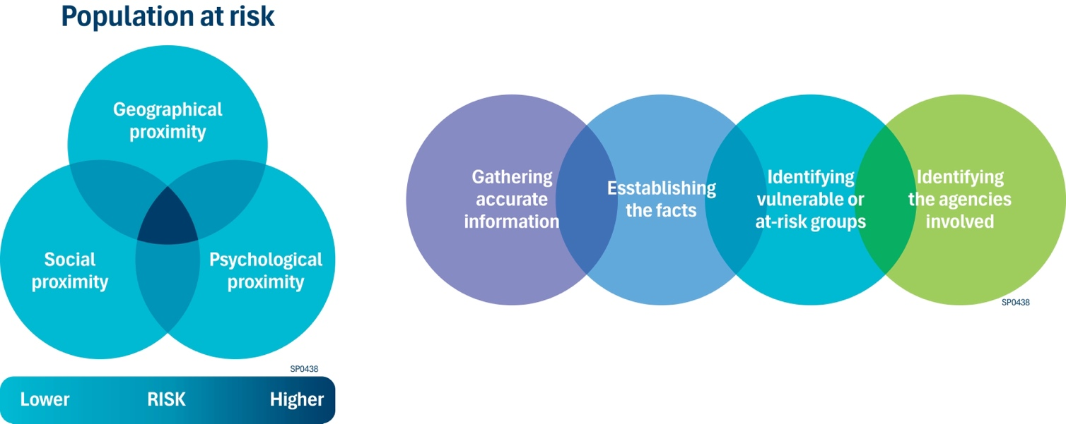
Identification of at risk and impacted individuals
Geographic proximity
Refers to people living in the same geographic area.
Social proximity
Refers to the relationship with person who has passed i.e. family, relative, close friend, work colleague, acquaintance etc.
Psychological proximity
Refers to the immediate impact of a suicide on individuals and communities, emphasising the need for preparedness and support.
Notes:
The identification of at-risk and impacted individuals in suicide postvention involves a multi-faceted approach that includes recognising the signs of distress, understanding the risk factors, and implementing strategies to support those affected by suicide.

Slide 13
Geographic proximity
Physical distance between the person and the incident. Note social media can extend the geographical boundaries of those that are vulnerable.
Examples:
Those that live in the same household
Those who discover the body
Those who have contact with the person shortly before they died
Those that live in the same street
Those who are exposed to the immediate aftermath (including first responders).

Slide 14
Social proximity
The relationship someone had with the deceased. Note a young person’s perception of closeness e.g. feeling close to the person because they travelled on the same bus together for years, even if they never spoke, has been found to significantly influence their level of risk. Examples:
Family members (for LGBTIQA+ community members, this may not be limited to kin)
Friends
Romantic partner or interest
Previous partner
Part of the same peer group or social circle
Team members at work
Health or other professionals who had been working with the deceased.

Slide 15
Psychological proximity
People who identify with the deceased or perceive themselves to be like the deceased in some way. For example, individuals of a similar age, sexual orientation, or those who have a cultural or religious connection. In instances where others see the deceased as a role model, there may be a wider circle of individuals that identity with them.
Examples:
Classmates or others attending the same school/college or workplace
Those attending the same sports club or other activity group
Those who perceive they have similar life problems to the deceased
Those that identify as being part of the LGBTIQA+ community.

Slide 16
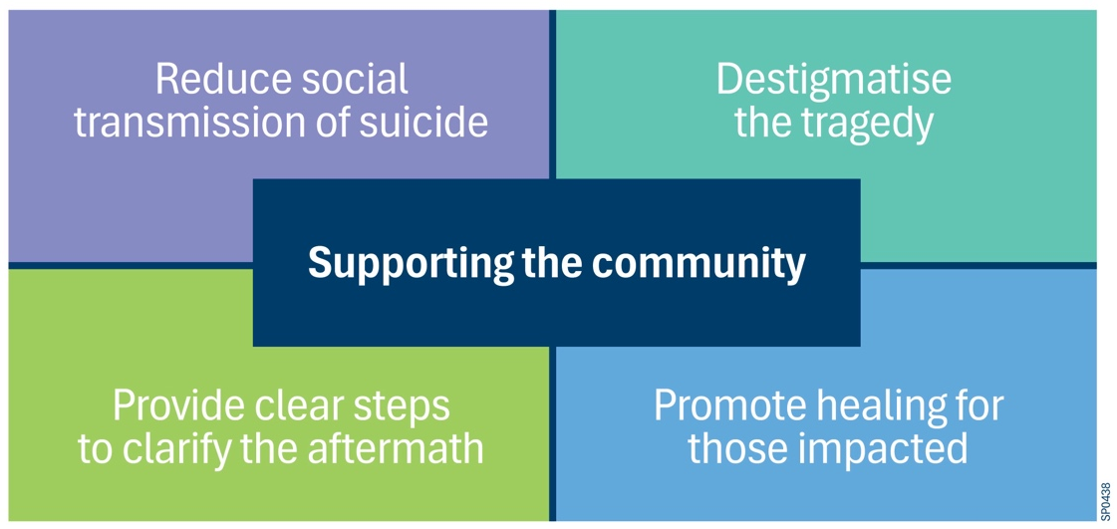
What is postvention?
Postvention programs work to destigmatise the tragedy of suicide, empower survivors and enhance suicide prevention efforts by providing a range of supportive resources, including behavioural, psychosocial, spiritual and public health services. By preventing further suicides, these supports actively contribute to suicide prevention.

Slide 17
Identify who you will involve in your postvention response
The Local Response Group (LRG) membership can typically include the following organisations:
Local government
Local health services
ACCO/ACCHOs
StandBy and Thirrili
Local Victoria Police
School, TAFE and university representatives
People with lived and living experience of suicide
Organisations that provide bereavement supports, peer-support, psychoeducation and wellbeing support.
Who else for your region or town needs to be involved?
Notes:
Slides 18 and 19 are interchangeable depending on the needs of the region.

Slide 18
Set out key steps and timelines to enact your response
A postvention protocol sets out the steps you will take to deliver a coordinated response and supports in your community to those impacted by a suicide or sudden death.
Step 1: Notification of the death | Chair of LRG informed by either VicPol, Ambulance Victoria, Standby or Thirrili.
Step 2: Monitoring and decision-making | Screening Gathering accurate information Identifying vulnerable or at-risk groups Identifying the agencies involved Deciding whether to activate a plan (Step2) risk assessment
Step 3: Activation | Taking specific consideration into account during initial stages Arranging different levels and types of support responses
Step 4: Deactivation | Decision when to deactivate the response against a set of deactivation criteria and considerations
Step 5: Evaluation | Evaluation, reviewing and assessing Sharing the learning
Notes:
Some questions to think about:
Your LRG.
What is the purpose of your organisation being at the table?
Being respectful to the person who has suicided and their family friends

Slide 19
Set out key steps and timelines to enact your response
A postvention protocol sets out the steps you will take to deliver a coordinated response and supports in your community to those impacted by a suicide or sudden death.
Step 1: Notification of the death | Chair of LRG informed by either VicPol, Ambulance Victoria, Standby or Thirrili.
Step 2: Monitoring and decision-making | Screening Gathering accurate information Identifying vulnerable or at-risk groups and agencies involved Deciding whether to activate a plan (Step2) risk assessment
Step 3a: Decision to activate | Taking specific consideration into account during initial stages Arranging different levels and types of support responses
Step 3b: Decision not to activate | Communication to LRG around incident and rationale not to activate LRG keep watching brief and be prepared to activate if need be.
Step 4: Deactivation | Decision when to deactivate the response against a set of deactivation criteria and considerations
Step 5: Evaluation | Evaluation, reviewing and assessing, and sharing the learning
Notes:
Slides 18 and 19 are interchangeable depending on the needs of the region.

Slide 20
Postvention in action: Scenario one
Deceased initials: TK
Gender: Female
Age: 17
Incident date: 6 April
Community: Local secondary school
Residence: Bright
Step 1: Notification of the death | Chair of LRG informed by either VicPol, Ambulance Victoria, Standby or Thirrili.
Step 2: Monitoring and decision-making | Screening Gathering accurate information Identifying vulnerable or at-risk groups and agencies involved Deciding whether to activate a plan (Step2) risk assessment
Step 3: Activation | Taking specific consideration into account during initial stages Arranging different levels and types of support responses
Step 4: Deactivation | Decision when to deactivate the response against a set of deactivation criteria and considerations
Step 5: Evaluation | Evaluation, reviewing and assessing, and sharing the learning

Slide 21
Postvention in action: Scenario two
Deceased initials: MN
Gender: Male
Age: 55
Incident date: 6 May
Community: Local workplace
Residence: Corryong
Step 1: Notification of the death | Chair of LRG informed by either VicPol, Ambulance Victoria, Standby or Thirrili.
Step 2: Monitoring and decision-making | Screening Gathering accurate information Identifying vulnerable or at-risk groups and agencies involved Deciding whether to activate a plan (Step2) risk assessment
Step 3: Activation | Taking specific consideration into account during initial stages Arranging different levels and types of support responses
Step 4: Deactivation | Decision when to deactivate the response against a set of deactivation criteria and considerations
Step 5: Evaluation | Evaluation, reviewing and assessing, and sharing the learning

Slide 22
Postvention in action: Scenario three
Deceased initials: EV
Gender: Male
Age: 23
Incident date: 6 June
Community: California
Residence: USA
Vocalist of a well-known rock band that is very popular among young people.
Step 1: Notification of the death | Chair of LRG informed by either VicPol, Ambulance Victoria, Standby or Thirrili.
Step 2: Monitoring and decision-making | Screening Gathering accurate information Identifying vulnerable or at-risk groups and agencies involved Deciding whether to activate a plan (Step2) risk assessment
Step 3: Activation | Taking specific consideration into account during initial stages Arranging different levels and types of support responses
Step 4: Deactivation | Decision when to deactivate the response against a set of deactivation criteria and considerations
Step 5: Evaluation | Evaluation, reviewing and assessing, and sharing the learning

Slide 23
Postvention in action: Scenario four
Deceased initials: EV
Gender: Male
Age: 23
Incident date: 6 March
Community: California
Residence: USA
Vocalist of a well-known rock band that is very popular among young people.
Step 1: Notification of the death | Chair of LRG informed by either VicPol, Ambulance Victoria, Standby or Thirrili.
Step 2: Monitoring and decision-making | Screening Gathering accurate information Identifying vulnerable or at-risk groups and agencies involved Deciding whether to activate a plan (Step2) risk assessment
Step 3: Activation | Taking specific consideration into account during initial stages Arranging different levels and types of support responses
Step 4: Deactivation | Decision when to deactivate the response against a set of deactivation criteria and considerations
Step 5: Evaluation | Evaluation, reviewing and assessing, and sharing the learning

Slide 24
What supports does a postvention response provide
Information including leaflets, books, booklets, factsheets, posters and online information
Assistance including support services, support groups, self-help groups, helplines, community support and educational support
Counselling
Psychotherapy
Wellbeing and self-care activities.
A postvention protocol sets out the steps you will take to deliver a coordinated response and supports in your community to those impacted by a suicide or sudden death.

Slide 25
Activation criteria
A yes to any of the following warrants an activation:
A risk of further suicidal behavior
Reasonable grounds to believe it was linked to a previous suicide or unexpected traumatic event in the community (e.g. individuals from the same school, place of employment, sports team etc)
The deceased was part of a group disproportionately represented in suicide statistics
Schools are impacted by the death
Relatives of the deceased still attend an education institution
The death has a direct impact on young people (counsellor, teacher, coach etc)
The deceased was well known or connected within the community
The death occurred in a public space
Multiple people were exposed to the incident in which the death occurred
The death is or has potential to receive, a lot of attention in the media/social media
The incident was broadcasted live through social media
There is the potential of significant community distress
There is potential for political interest.

Slide 26
Deactivation
If the deactivation criteria is met, it is important to communicate this to members of the Local Response Group and ensure that everyone is directed to ongoing support services where needed.
Once the response is deactivated, the Local Response Group will meet to evaluate the process. After evaluating the response, you can transition to suicide prevention activities in the community to address any gaps and needs identified during evaluation.
The following criteria should be considered in your deactivation protocol:
  Reduced harm: assessment shows lower likelihood of further harm or impact to the community
  Calm in the community: the community feels more stable and contained
  Decreased media presence: media coverage of the event no longer poses a harm
  Sufficient support: existing services are well integrated and can meet the needs of the community
  All response activities complete: all items in the action plan have been completed and feedback provided as required.

Slide 27
Evaluation
After a response has been deactivated, it is important to integrate feedback into key learnings to inform future changes or improvements to the postvention response.
Key questions to guide your evaluation meeting include:
  Were there any challenges or barriers to implementing effective supports?
  Did the notification and activation process run smoothly, or does it need adjusting?
  What was the uptake of supports provided in the community?
  Was any feedback received from those who used these supports?
  Were the resources provided useful?
  Is there any training the Local Response Group members could benefit from?
  Have opportunities for capacity building in the community been identified and what actions can be taken?
  What suicide prevention activities could strengthen future responses?
Following the evaluation meeting, update the Postvention Protocol if necessary, based on lessons learned and improvements identified.

Slide 28
Suicide prevention activities
The Local Response Group should outline opportunities for to suicide prevention in the community, involving a broad range of stakeholders.
  Gatekeeper training e.g. ASSIT, safeTALK, Mental Health First Aid
  Suicide Prevention campaigns
  Support attendance at professional development.

Slide 29
Postvention in action
Response timeframe
Within the first week | The Chair convenes a meeting of the LRG to occur within the first week The LRG determines those that may have been impacted Assess the need for intervention and support in the community Cultural considerations and adjustments are made to ensure a safe and supportive response for all Members begin to act on the agreed items of support as identified in the Action Plan.
Weeks 1 – 4 and beyond | The designated coordinator contacts member organisations to ensure actions are completed, identify any gaps, and offer additional support as needed Updates are provided to the LRG via email regarding any changes to action items The Chair in consultation with LRG members determines if a further meeting is required or if the protocol can be deactivated An evaluation meeting is held to capture any learnings and agree changes needed to the protocol.

Slide 30
Templates
Meeting agenda
Contact sheet
Evaluation
Communication

Slide 31
Governance and compliance
Compliance with statutory obligations
Privacy, confidentiality and duty of care
Deceased persons
Living persons
Alignment with existing protocols

Slide 32
Next steps
[Organisation] to complete the next draft of the Protocol based on feedback from today’s workshop and further conversations with host organisation.
Local Response Group to meet in ……..
Workshop two in ……..

Slide 33
Self-care activity
What activity do you love to do that fills your cup?

Slide 34
Workshop close
Last thoughts and comments?
Notes:
Thank you for your participation.

